Slide 1

Analysis of Research in Healthcare Data Analytics

Slide 2
INTRODUCTION
Today’s healthcare industries are moving from volume-based business into value-based business, which requires an overwork from doctors and nurses to be more productive and efficient.
Over the last few years, healthcare data has become more complex for the reason that large amount of data are being available lately, along with the rapid change of technologies and mobile applications and new diseases have discovered.
This paper aims to proof that healthcare data analytics techniques are not efficient enough and suitable anymore these days in order to manage big data issue and improve healthcare data analytics due to the rapid growth and evolution of technology.
In order to meet our goals, the proposed study is going to discuss critically weaknesses, disadvantages, problems and gaps of traditional healthcare data analytics techniques in order to manage healthcare big data.
The proposed technique is recommended rather than offered, since it will facilitate and enhance healthcare practice, by enabling systems to use data and analyze it efficiently and smoothly, because it will fill the gaps of previous techniques used in the hospitals, handle big data issue and avoid data loss, which will lead to improve care, assist diseases prediction and prevention systems and reduce cost.
By sure Doctors and nurses will be benefited by using a proposed technique which reduce time and efforts.

Slide 3
Healthcare Analytics & Data Mining
Data Mining is described as a process by which data is gathered, analyzed and stored in order to produce useful and high quality information and knowledge.
This term also includes the way of how this data is gathered, filtering and preparation of the data for use and finally the processing of data to support data analytics and predictive modelling
Data collection:
The first stage of data mining is the process of gathering and collecting data.
However, even before gathering the data, ideas and plans should be assumed to decide which data should be gathered in order to collect specific data as desired and use it efficiently

Slide 4
Healthcare Sectors & Big Data Analytics
Big data storage and management
One of the most important elements in dealing with and managing data is to know where and how this data will be stored once when it is collected.
There are many numbers of data sources now and that a huge amount of data has become available, so this growth of data will absolutely require an agile database which can deal with the data logically and through data synchronization in order to adapt to the rapid data evolution.
On the other hand databases only manage server memory data, therefore eliminating the option of managing other storage devices such as: disk and compact drivers.
Accordingly, this will reduce the efficiency of database performance and real time response during the time.

Slide 5
Healthcare Sectors & Big Data Analytics
Patients Role in Healthcare Analytics
This can improve healthcare analytics through understanding the small and personal data, as well as educate themselves in how to collaborate with the healthcare data analytics to reach a high level of efficiency and accuracy.
to perform good data analytics, first of all we should teach individuals how to understand and realize the importance of dealing with such data.
Patients can share some information with other patients, so they increase their knowledge, background and awareness in the healthcare analytics sectors regarding their conditions.
Connectivity between Healthcare Analytics System and Individuals (Medical Staff and Patients):
Connectivity approaches generate thoughts and ideas from connected networks of minds and leverages prior experiences with the utilization of technologies in our everyday life.
it is also regards how much individuals are attached to and familiar with medical care systems and their personal skills such as ability to learn and adopt such systems in their life, as different people have different attitudes and reasons for not accepting such technologies

Slide 6
Healthcare Sectors & Big Data Analytics
Healthcare Predictions and Decision Support System (DSS):
Healthcare prediction is another data analytics method focusing on reducing future medical costs. Predictive technique uses patient medical history to evaluate all the potential health risks and predict a future medical treatment in advance.
Role of Predictive Analytics in Medical Healthcare:
Predictive analytics supports healthcare sectors to achieve a high level of effective overall care and preventive care,
As predictive systems’ results allow treatments and actions to be taken when all the risks are recognized in early stages, which aids for minimizing costs.
The technology era has added significant value to the healthcare decision support system.
Financial Factors in Healthcare Predictive Analytics:
Because of cost, information is one of the main aspects that have a big effect on the cost of healthcare predictive analytics.
Medical care systems have focused on increasing healthcare analytics performance as well as minimizing the cost by simplify unstructured clinical record and reducing irregular information.

Slide 7
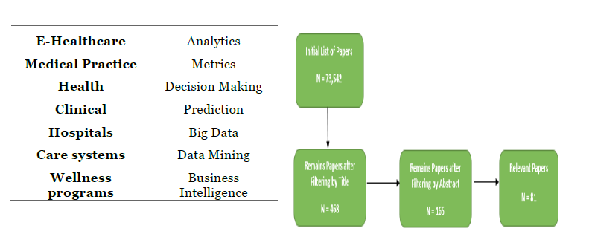
METHOD
Method has followed three steps:
1) searching for initial and related studies,
2) Relevance appraisal
3)evaluation and extracting data.
The first step in order to find the articles was to specify and identify main keywords, This study has found that most relevant keywords to “healthcare analytics” and “data mining” used with technology to support medical information systems.

Slide 8
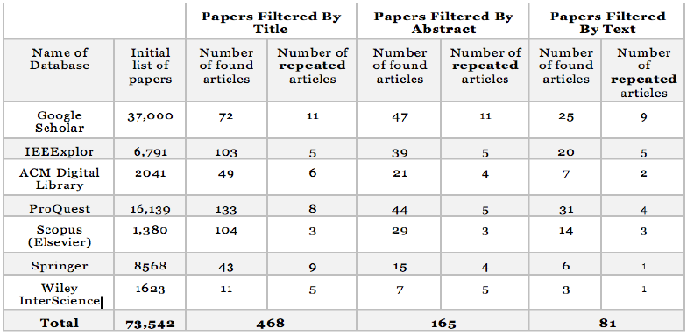
METHOD
Once the keywords were identified, 7 online databases were searched to find the initial list of the studies. In the search, titles, keywords, abstract and full text were considered and the search was limited to studies published since 2010.
Relevance and related papers step was completed by filtering relevant papers from the initial papers list and eliminating undesired ones, by filtering papers first based on titles, abstracts and finally full texts.

Slide 9
METHOD
Main factors in Eliminating articles or papers such as:
• Did not focus on utilizing technologies in order to improve healthcare analytics.
• Did not provide any applicable methods and experimental evidence.
• Were in different languages not English.
• Were not relevant enough and kind of old, which cannot be applied in these days.
• Were not available anymore.
Finally, Extracting and Analysis of data step comes after specifying and identifying related papers, so from
1) The year of publications
2) methods and tools have been used professionals
3) investigate if these tools and methods are still useful now a days or not
4) what kind of problems that have been solved using these tools
5) role of patients’ in order to assist healthcare analytics and improve medical care decision process
6) application areas
7) research approaches and
8) Data availability and geographical area of data gathering.

Slide 10
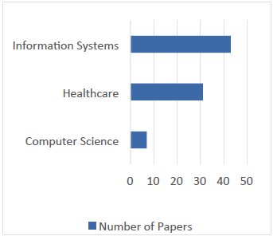
RESULT
Fields of Publication:
Found Information Systems with 43 papers and Healthcare with 31 papers as most active communities in the research related to the healthcare analytics topic, however 7 papers were published related to the healthcare analytics in Computer Science.

Slide 11
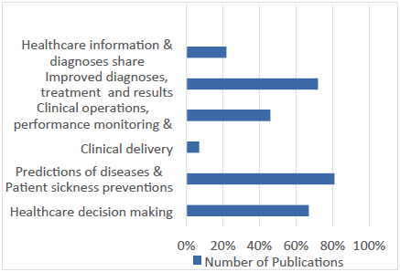
RESULT
Application Areas:
This paper found that healthcare analytics papers has focused on six main areas:
(a) healthcare decision making
(b) predictions of diseases & patient sickness preventions
(c) clinical delivery
(d) clinical operations, performance monitoring & reporting
(e) Improved diagnoses, treatment and results and finally
(f) Healthcare information exchange.

Slide 12

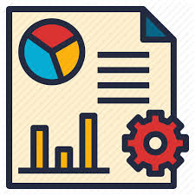
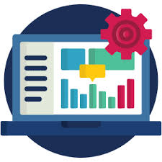
RESULT
Healthcare Data Analytics Platforms and Tools:
Advanced Data Visualization (ADV)
Presto
Hive
Vertica
Key Point Indicator(KPI)
Online Analytics Processing
Online Transaction Processing
Hadoop Distributed File System
Casandra File system
Map Reducing System
Text mining
Cloud computing

Slide 13
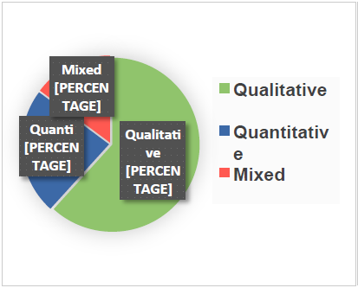
RESULT
Research Approaches:
Out of 81 studies included in this systematic review, 50 studies have adopted qualitative research approach, 19 studies used quantitative methods, and finally 12 studies used a mixture between qualitative and quantitative research approaches.
Below figure shows that the qualitative research has focused more by understanding the individual behavior between patients and doctors in order to improve results.

Slide 14
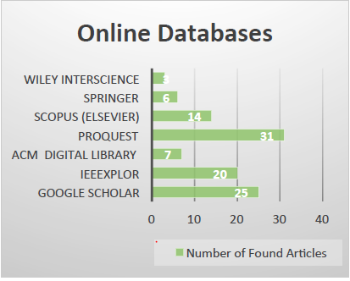
RESULT
Online Databases:
This literature review has found a total number of 81 papers were considered highly relevant to the healthcare analytics after studying of seven databases, whereas 25 articles were repeated in different databases.

Slide 15
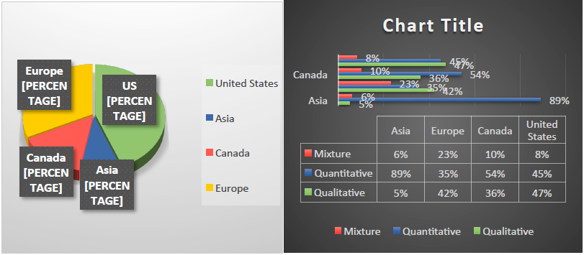
RESULT
Geographic distribution:
Most of healthcare data analytics has been conducted in the United States and Europe, however there were some studies in Canada and very little in Asia.
From the figure shows the distribution of research approaches in different areas. As we can see that United States and Canada have got kind of attention for both quantitative and qualitative studies. however in Europe qualitative studies have more attention than quantitative studies

Slide 16


